Slide 1
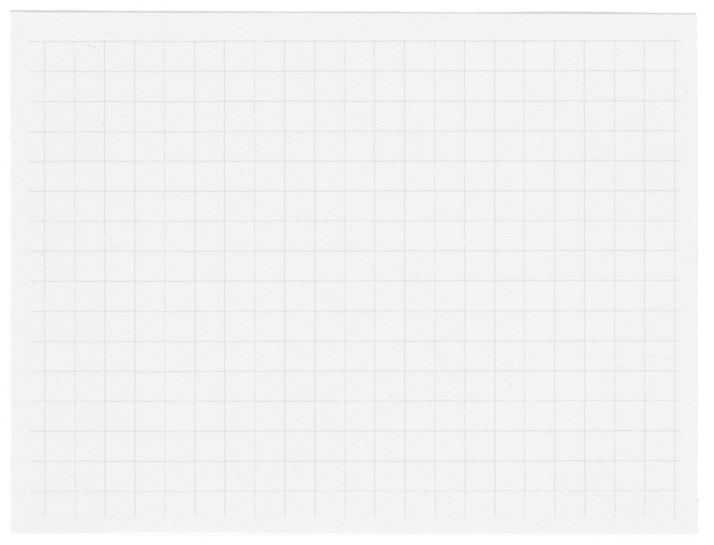
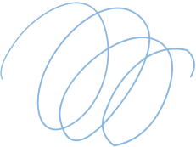


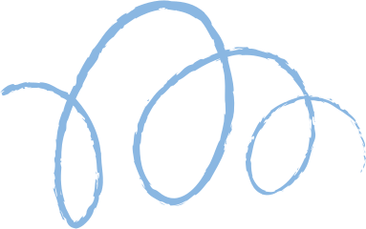









EE675 Project Endterm Report
Decentralised Solution for MIS Problem Using RL
Instructor: Dr. Subrahmanya Peruru
Shivam Gupta - 210980
Monkesh Singh - 210631
Harshit Gupta - 210422

Slide 2
Link for presentation video:
https://youtu.be/5qHeDZnt27o
Link of code:
https://github.com/Harshit1380/EE675

Slide 3
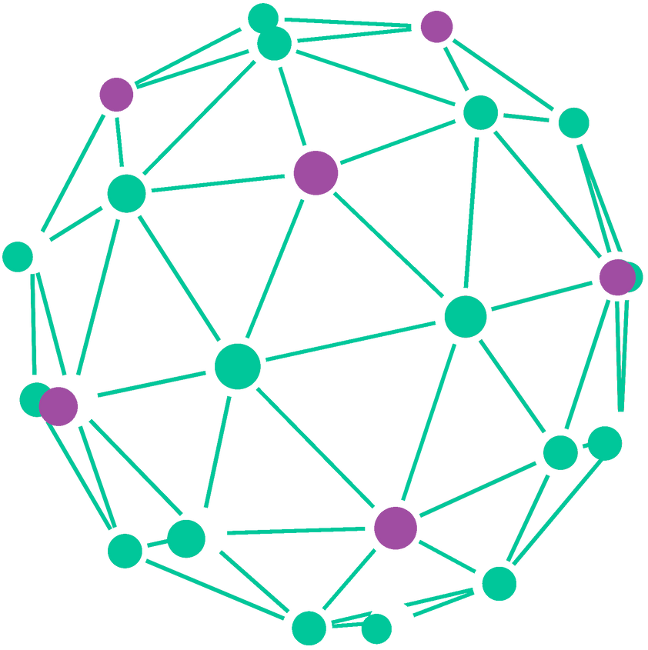
Problem Definition
Maximum Independent set(MIS)
The Maximum Independent Set (MIS) is a fundamental concept in graph theory, particularly in combinatorial optimization. It refers to the largest possible subset of vertices within a graph where no two vertices are adjacent to each other.

Slide 4
What We Discussed
Maximum Independent Set
Possible solutions for the MIS problem
Discussed 2 papers for RL solution for MIS
Learning What to Defer
Regularized off-policy RL
Discussed 1 paper with decentralised approach solution for MIS
Got a brief on Multi-Agent Reinforcement learning

Slide 5
Our Approch
Used Cooperative MARL approach as discussed earlier
Used offline approach, updating policy after each episode
Used PPO actor-critic approach which is a policy gradient approach
Agents: assign agents to each node
Observes locally, taking the state of its neighbour's node
A common reward is given to each node after a transition end

Slide 6
Markov Decision Process
Environment: Created an environment from scratch and built all necessary functions. e.g.-
initialize_global_state: Initiates the graph with all deferred vertices
calculate_reward: Calculates reward as we move from one state to the other.
check_termination: Checks if the episode is terminated or not
reset: Resets the environment where each node is deferred.
step: Makes a transition from one state to the other
and more...

Slide 7
Markov Decision Process
States: 0->differ, 1->include and 2->exclude
State of the System: Set of states of each node at a particular time ‘t’
State of each Agent: Information of its own state and neighbour nodes
Transition: s(t) -> s’ (an intermediate step) -> s(t+1)
Intermediate Steps:
Convert two adjacent included nodes to deferred node
If a node is included, then all deferred nodes adjacent to it will be excluded
If all adjacent nodes of a deferred node are excluded, then it will be included

Slide 8
Markov Decision Process
Rewards:
Main reward: (#included nodes in state s(t+1)) -(#included nodes in state s(t))
Penalty: -1 for each adjacent node being selected while taking an action
Penalty: -1 for each step taken in reaching the terminal state
This reward will be given to each node/agent equally

Slide 9
Algorithm
At each step, agents take individual actions
Cumulative action is given to the environment as a step
Episode is being completed. States, Actions, and Rewards data are saved
Each agent is being represented as a PPO agent with its own Actor and Critic model
For each agent, we use the loss function for training
Gradient descent is being used to minimize the loss function

Slide 10
Code Implementation

Slide 11
Thank you very much!

